Slide 1

Uncovering Hidden Demand Shift in Bike Sharing
A combined approach using time series, clustering, and anomaly detection
Course
Presented By
Data Mining (DT8013)
Vishnupriya , Nancy , Rida

Slide 2
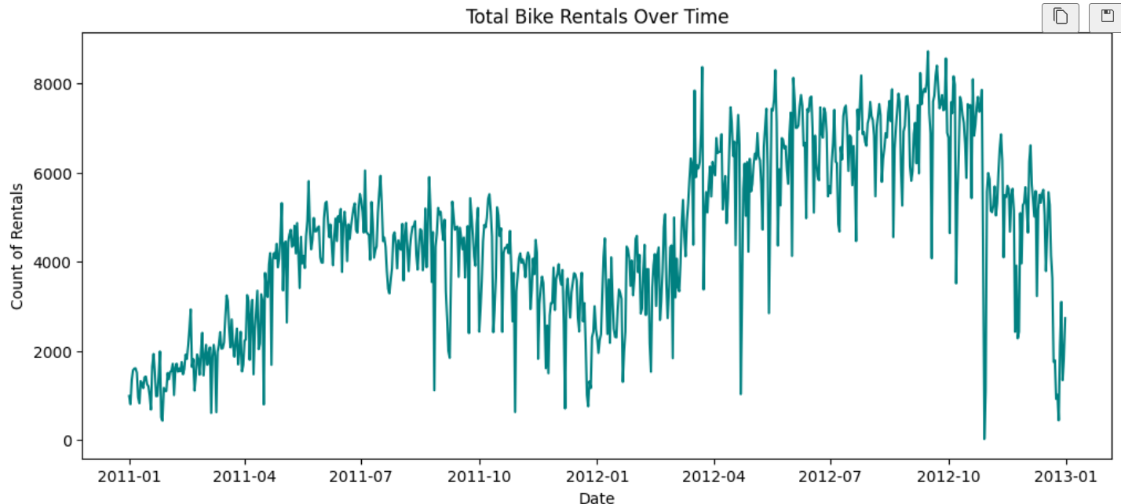

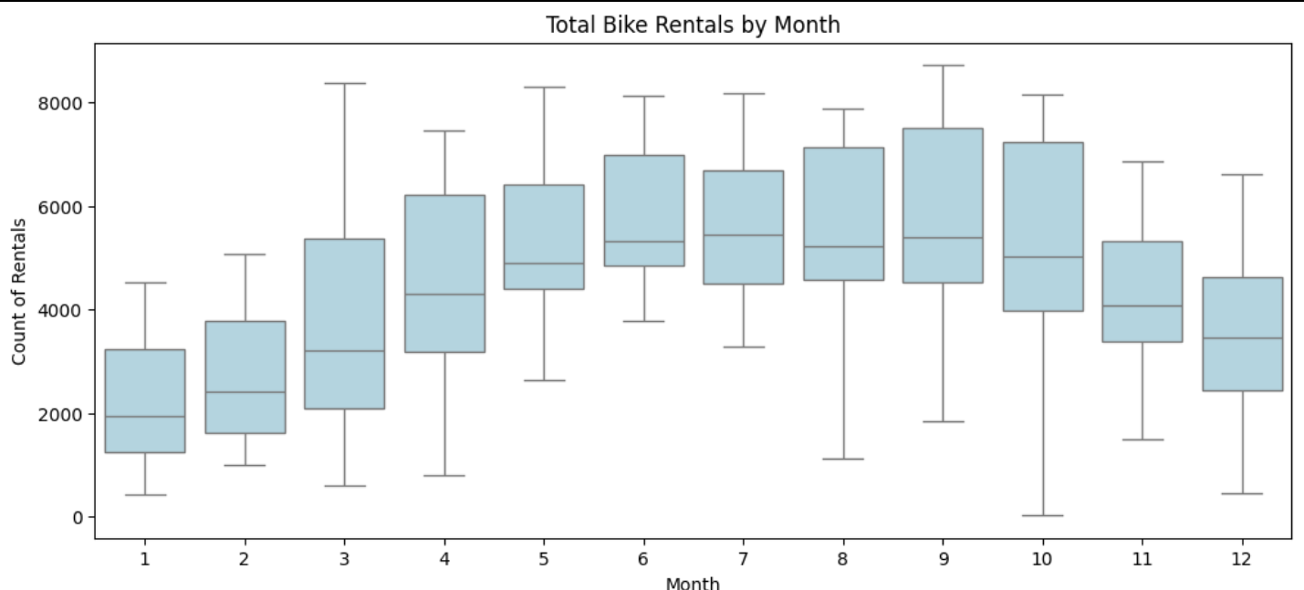
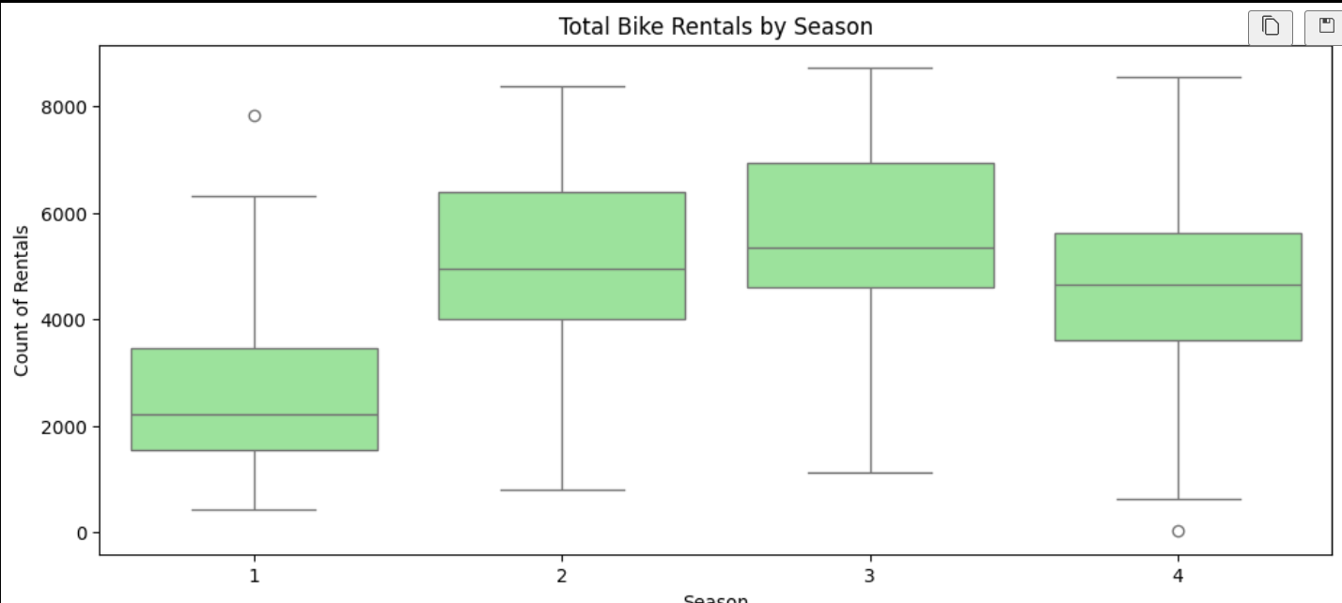
Research Question & Goal
We applied core data mining techniques to the UCI Bike-Sharing dataset to discover actionable insights for optimizing logistics and resource allocation.
Core Question
"What are the deviations in rush hour demand?"
Hidden Patterns
Discover unusual behavior during peak demand periods to reveal demand regime shifts and operational vulnerabilities. .(Lecture Intrestingness – Slide 3)

Slide 3
Project Goal & Problem Statement
1
2
Problem Statement
Core Goal
Bike-sharing demand is highly volatile, driven by predictable factors (Time/Season) and unpredictable shifts (Events/Anomalies).
To go beyond simple forecasting and uncover the underlying structures (hidden shifts) in demand.
3
4
Combined Methodology
KDD Context
Time Series Analysis: Model base demand, trend, and seasonality
This project aligns with the Hands-on Experience goal of applying "hot topics" like Anomaly Detection (AD), Time Series Analysis (TSA), and Clustering to a real-world dataset.
Clustering: Segment days/periods into distinct demand regimes
Anomaly Detection: Identify sudden, unexpected demand shifts that deviate from normal patterns

Slide 4
Methodology: Four-Phase Approach
Our analysis follows a structured pipeline combining preprocessing, clustering, anomaly detection, and visualization to uncover meaningful demand patterns.
Phase 2: Recognition
Phase 1: Preparation
Use clustering to identify stable demand patterns
(Lecture 3- slide 29)
Transform and preprocess data for analysis
(Introduction –slide 3)
Phase 4: Communication
Phase 3: Deviation Analysis
Visualize and communicate final insights
(lecture 2 Data Visualization : slide 3 )
Apply anomaly detection to find rush hour deviations

Slide 5

Phase 1: Data Preparation
Hourly data was aggregated into 24-dimensional daily profiles capturing full usage trends. Normalization was applied to prevent bias from high rush-hour magnitudes in distance calculations.
Feature Engineering
Aggregated hourly data into daily 24-hour profiles to capture complete usage patterns
Normalization
Applied scaling to ensure Euclidean distance calculations in K-Means are unbiased by rush-hour magnitude (Lecture 3 Clustering – Slide 29)
External Features
Incorporated weather and holiday indicators as explanatory variables for anomalies

Slide 6

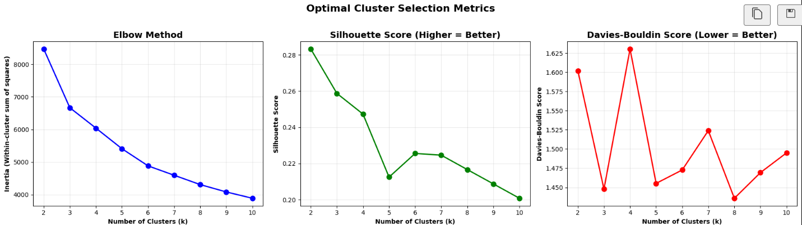
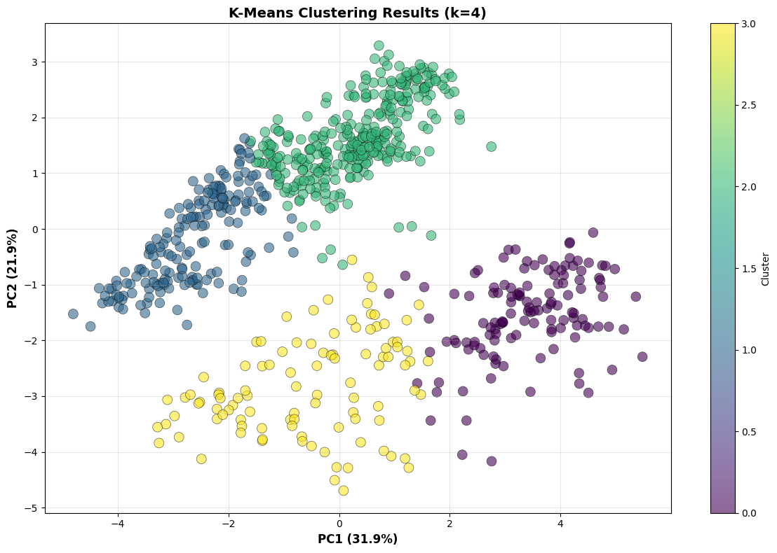
Phase 2: Pattern Recognition Through Clustering
K-Means clustering revealed two distinct demand regimes within bike-sharing usage, representing fundamentally different behavioral patterns that require separate operational strategies.
Method
Result
K-Means Clustering (partition-based approach) identified stable demand regimes within the dataset. .(Lecture 3 Clustering– Slide 4)
Two major, distinct clusters discovered, representing two hidden demand shifts in bike-sharing behavior.

Slide 7
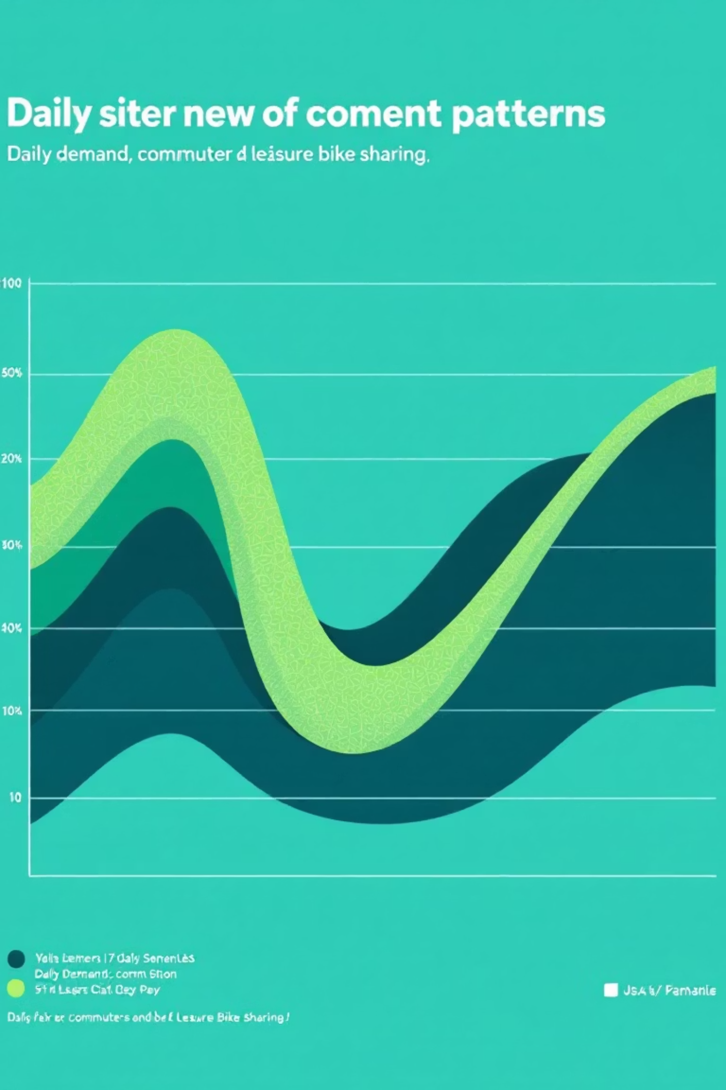
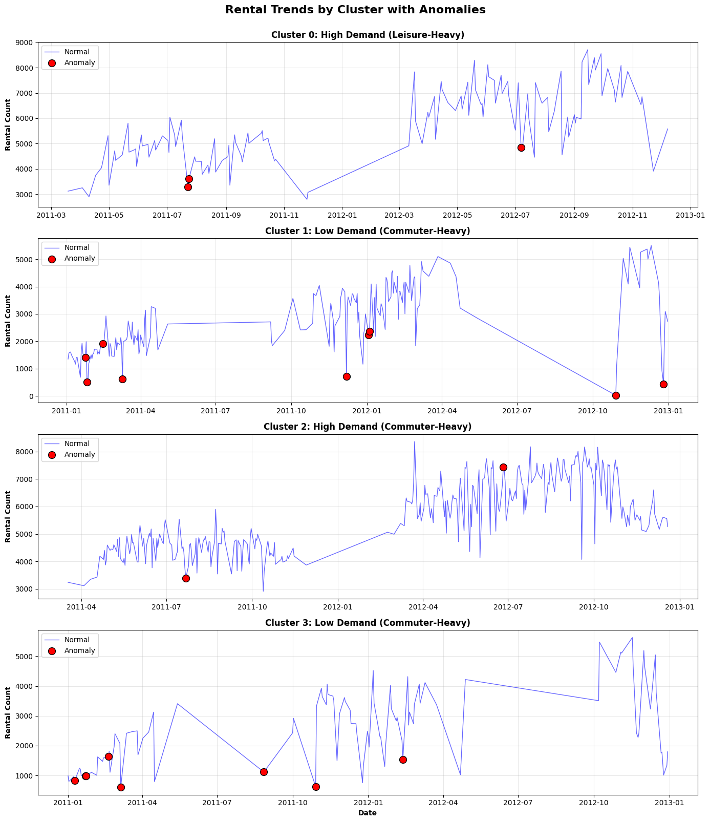

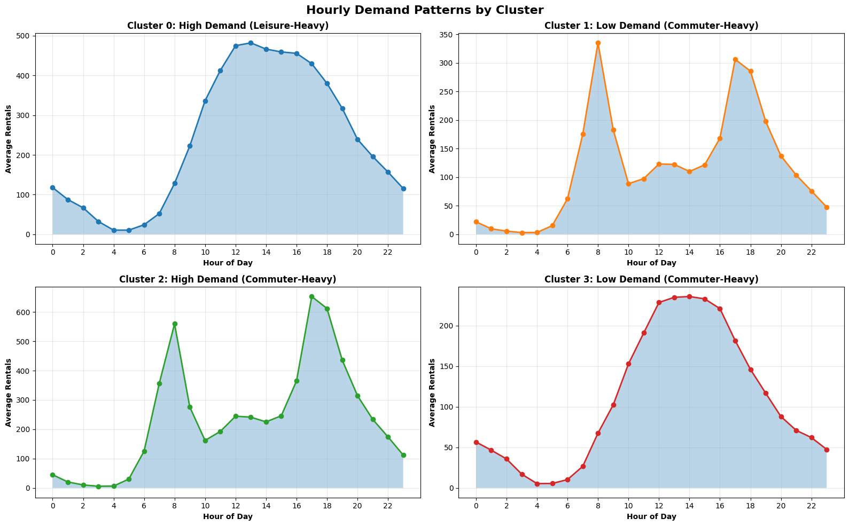

Key Finding 1: Two Hidden Demand Profiles
Commuter Profile
Clear double-peaks at morning and afternoon rush hours, representing work-related travel on standard weekdays.
Leisure Profile
Single gradual peak spanning noon to late afternoon, representing recreational non-work usage patterns.
Critical Insight: Operational planning must recognize a day's true usage profile rather than relying solely on workingday classification flags.
Notes:
Hourly Pattern Interpretation: Cluster 0 (High Demand (Leisure-Heavy)): Peak hours: [13, 12, 14] Pattern: LEISURE (midday peak) Cluster 1 (Low Demand (Commuter-Heavy)): Peak hours: [8, 17, 18] Pattern: COMMUTER (morning/evening peaks) Cluster 2 (High Demand (Commuter-Heavy)): Peak hours: [17, 18, 8] Pattern: COMMUTER (morning/evening peaks) Cluster 3 (Low Demand (Commuter-Heavy)): Peak hours: [14, 13, 15] Pattern: LEISURE (midday peak)

Slide 8

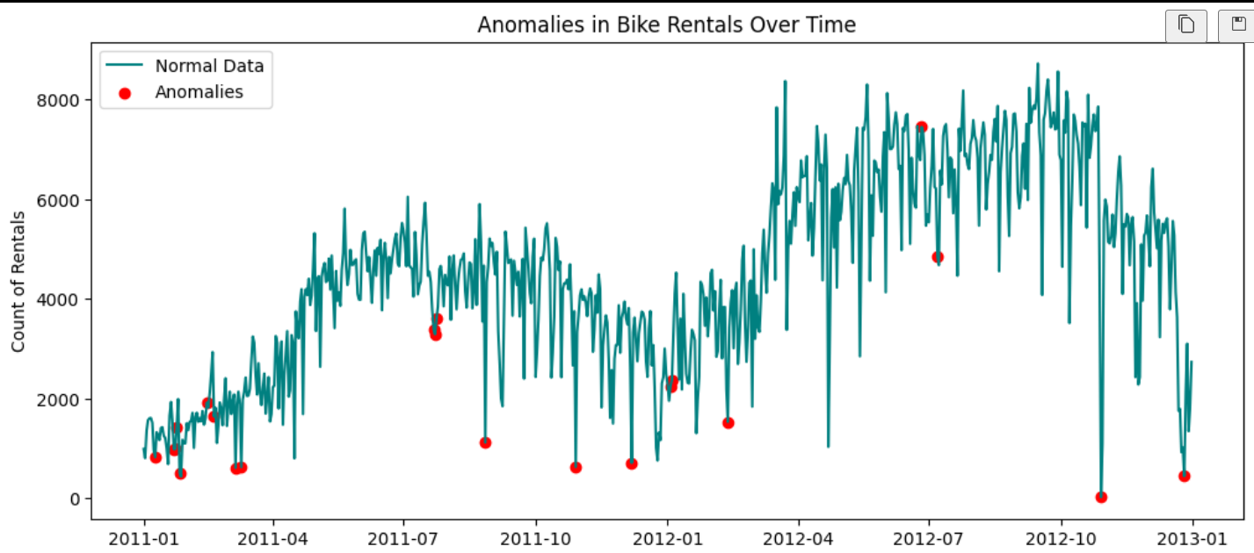
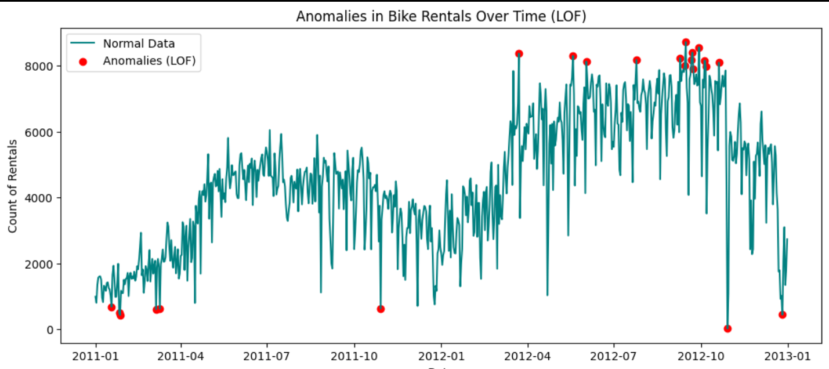
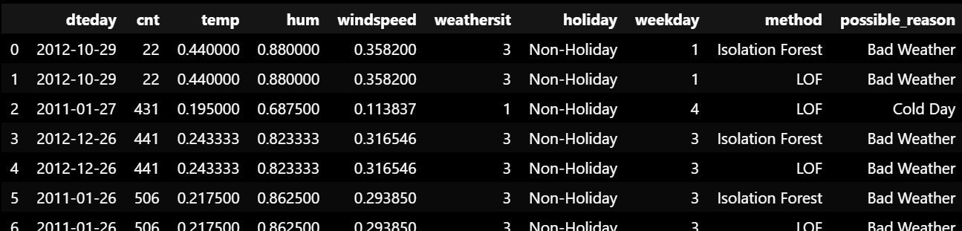
Isolation Forest
Phase 3: Anomaly Detection Framework
Clustering-based anomaly detection identified days where demand deviated from expected patterns.(Anomaly Detection (2) – Slide 2) Anomaly scores were calculated as Euclidean distances from assigned cluster centroids, with focus on largest rush-hour deviations.
Definition
Scoring
An anomaly is a pattern that does not conform to expected cluster behavior (Anomaly Detection (1) – Slide 3)
Distance from assigned cluster centroid serves as the anomaly score
Focus
Analysis filtered to largest deviations specifically in rush-hour demand
LOF BASED

Slide 9
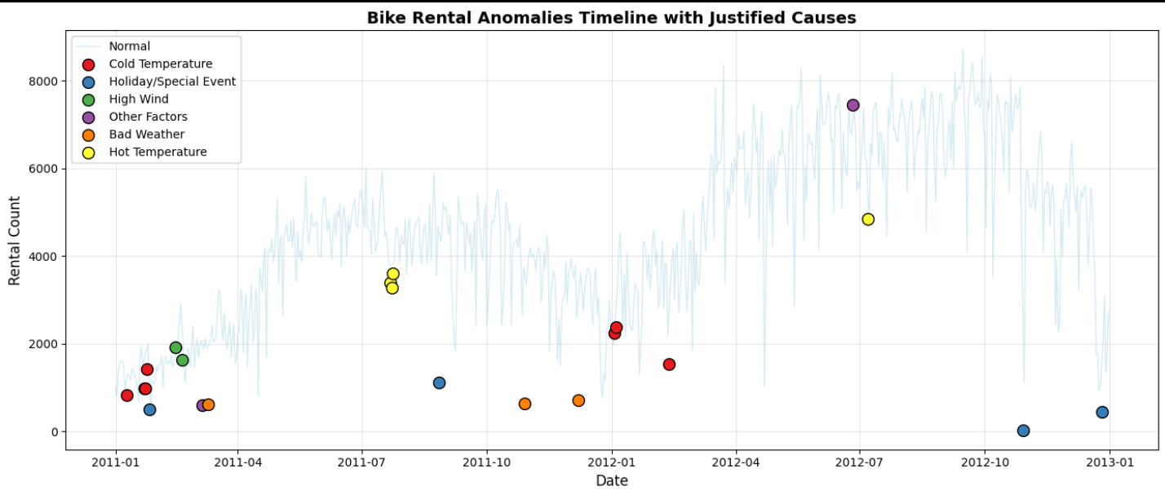
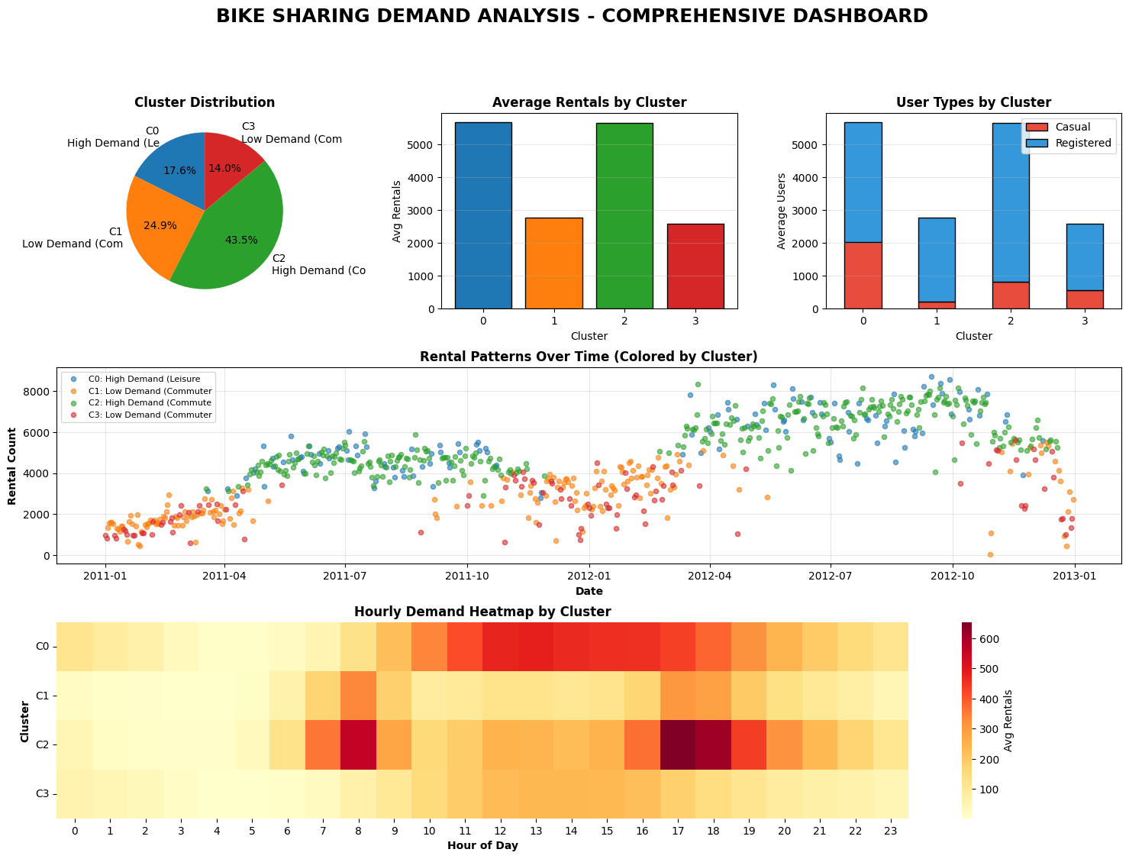


Key Finding 2: Weather Impact on Rush Hours
The most severe demand drops during rush hours correlated strongly with extreme weather conditions, including severe cold, heat, and poor weather events. This causes operational over-stocking when facilities are prepared for expected commuter demand.
Observation
Root Cause
Largest anomalies registered as severe demand drops during peak commute times
Extreme weather disrupts expected "Commuter Profile," forcing behavioral shift away from bike usage
Weather-driven anomalies are predictable and critical for resource planning and inventory management.

Slide 10

Key Finding 3: The Holiday Effect
Many days adjacent to holidays were flagged as anomalies despite being marked as working days. These days showed behavioral shifts from high-volume commuter patterns to low-volume leisure profiles, representing false commuters.
1
Observation
2
Significance
3
Implication
Working days adjacent to holidays exhibited leisure profile characteristics rather than commuter patterns
Predictable deviation that prevents operational failure when relying on day-type classification alone Lecture interestingness – Slide 2)
Calendar context and holiday proximity must inform demand forecasting and resource allocation strategies

Slide 11

Challenges & Solutions
Three critical challenges emerged during our analysis, each requiring specific methodological approaches to overcome data complexity and ensure valid insights.
Dimensionality
1
24-dimensional daily profiles required dimension reduction (PCA) for meaningful cluster visualization and interpretation
Anomaly Threshold
2
Defining statistical cutoff for anomalous centroid distances required careful tuning to minimize false positives while capturing genuine deviations
Interpretation
3
Connecting anomaly flags to causal factors (weather vs. holiday) demanded rigorous external feature analysis and domain validation

Slide 12

Recommendation 1: Dynamic Redistribution
Problem
1
Current static planning models struggle when commuter profiles deviate from expectations, leading to inefficient resource allocation and overstocking of bikes.
Action
2
Implement predictive logic to integrate real-time weather forecasts. Should extreme weather be anticipated, the system will dynamically switch the expected daily usage profile from 'Commuter' to 'Leisure'.
Result
3
This proactive adjustment will minimize manual redistribution efforts and reduce operational costs, ensuring optimal bike availability.

Slide 13

Recommendation 2: Calendar-Based Profile Switching
Problem
1
The system fails to predict low commuter demand on days near holidays.
Action
2
Officially classify all Holidays AND adjacent working days to use the low-volume Leisure Profile model for logistics planning.
Result
3
Ensures staffing and maintenance align with actual user demand patterns, improving service quality.

Slide 14
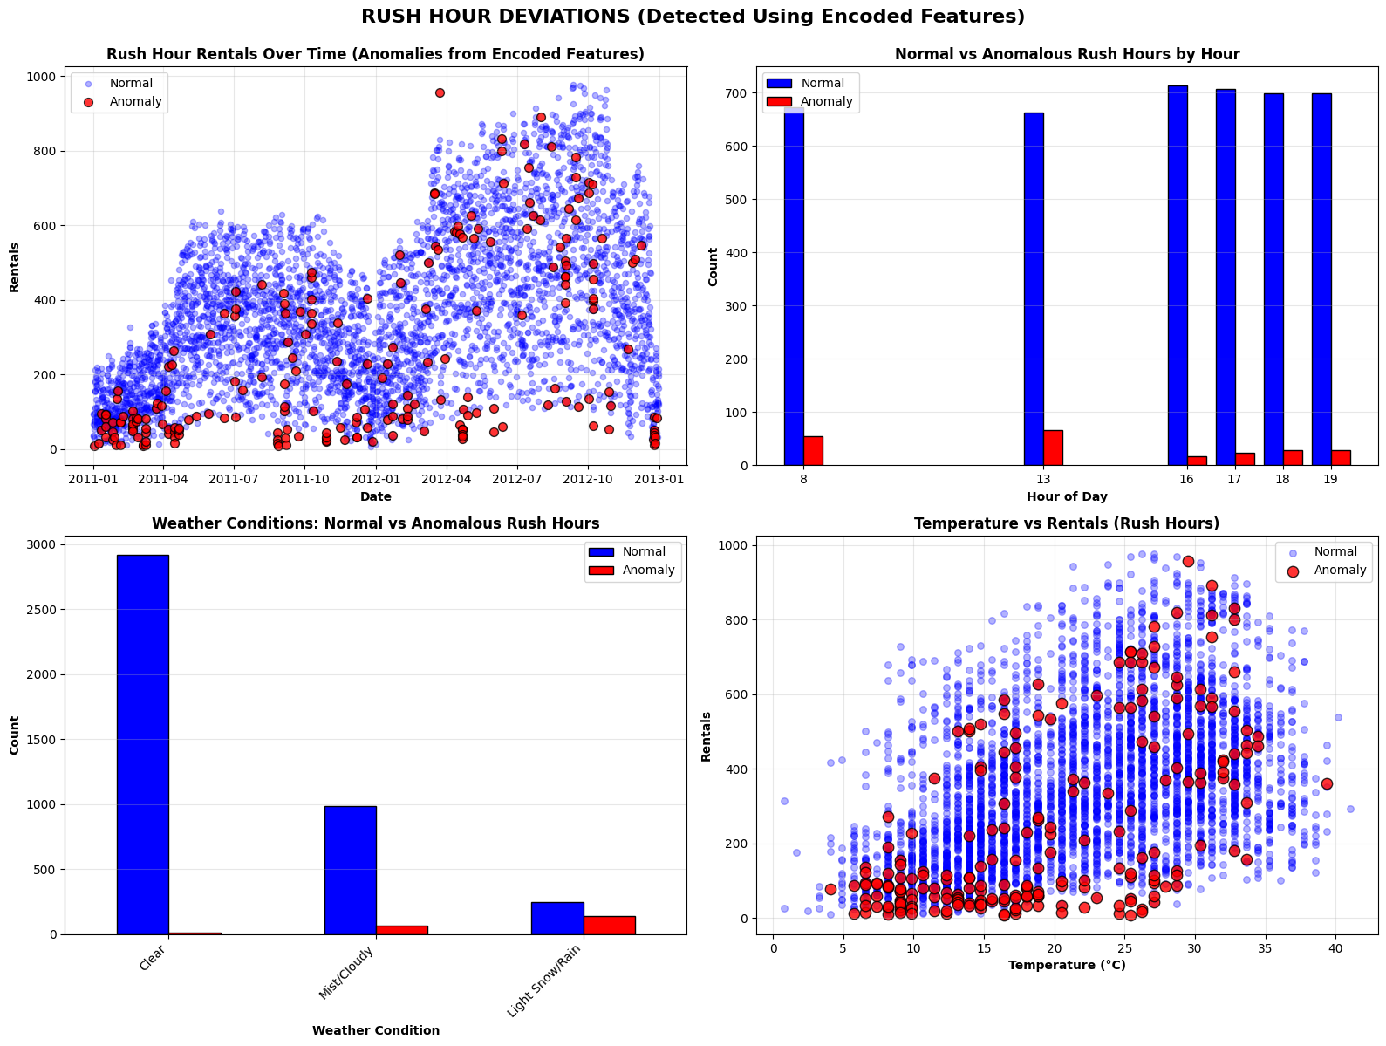

Summary of Key Findings
Finding 1
1
Two stable demand regimes (Commuter/Leisure) define daily usage
patterns.
Finding 2
2
Severe rush hour drops are highly predictable and correlate strongly with
extreme weather.
Finding 3
3
The model identified a predictable demand shift near holidays that must
be accounted for in planning.
Final Statement: We have successfully answered the question: What are the deviations in the rush hour?

Slide 15

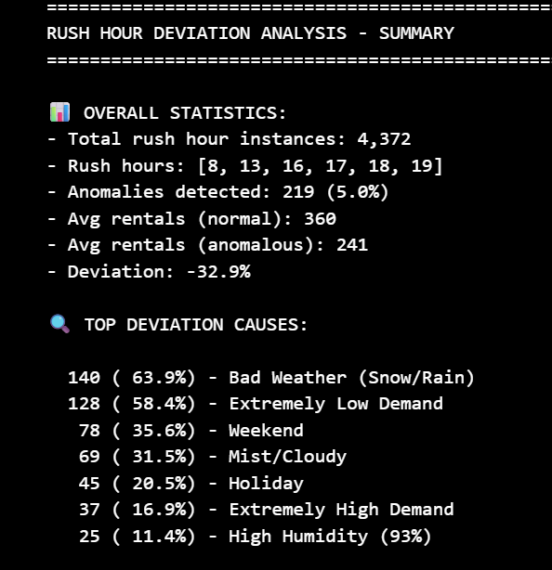
Conclusion
1
Impact
The combined approach successfully characterized "expected behavior" via clustering and explained "deviations" via anomaly analysis.
2
Value
This work supports a shift from reactive logistics to proactive, dynamic planning, improving both service and efficiency.
3
Quote
"An anomaly (or outlier) is a pattern in the data that does not conform to the expected behavior."
Anomaly Detection (1) – Slide 3

Slide 16

Thank You
Questions & Discussion

